Slide 1

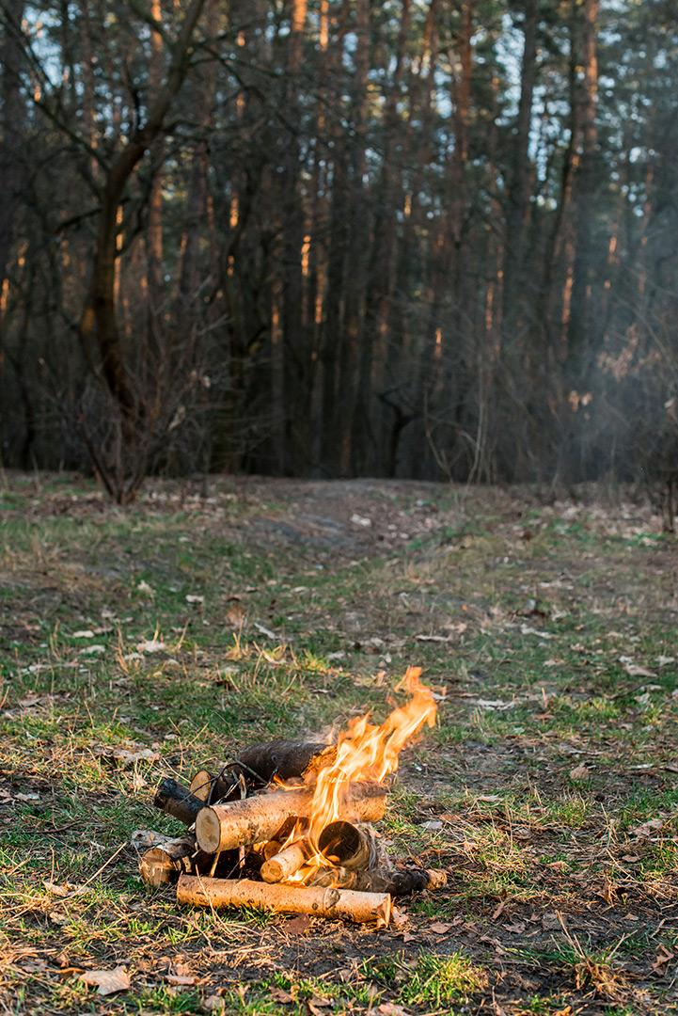
Web App Wildfire Detection
Team: CHIPouro

Slide 2
General Idea
This project brings forward a smart system that uses AI to spot wildfires early. It looks at pictures to find smoke and fire, and quickly sends out alerts.
Right now, the system acts like it's getting images from drones by having people upload them. The way it's built, using Flask and a strong database, means it can grow and handle more in the future. It's designed to be easily scalable.
The goal is to hook this up to real drones to watch from the sky in real-time. Later on, they also want to use it to help protect wildlife and study the environment. These use cases will involve environmental data analysis.
By using AI, the aim is to get to wildfires faster and make them less damaging. Finding wildfires early is super important, and this platform can do that. It proactively mitigates fire risks.
Regrettably, the limited timeframe of the hackathon restricted our ability to engage in more sophisticated machine learning training and/or incorporating drone simulation APIs. The current models leave a lot to be desired. It is essential to explore more complex architectures, conduct extensive hyperparameter tuning, implement dataset preprocessing, and utilize ensembling and cross-validation techniques to enhance the model's generalization capabilities and achieve overall better results. Regardless, this outlines a strategic plan for the future development of this repo.

Slide 3
Rights
This Web App is licensed under the Apache License 2.0, a permissive open-source license that grants users the right to use, modify, and distribute the software, including for commercial purposes. The license ensures that:
Contributors retain copyright and are granted a patent license, protecting them from future patent claims.
Redistribution of the software, including modifications, must include proper attribution and the full license.
The software is provided "as-is," with no warranties, and the authors are not liable for any issues arising from its use.
This license fosters broad usage and collaboration while ensuring legal protection for both users and contributors.

Slide 4
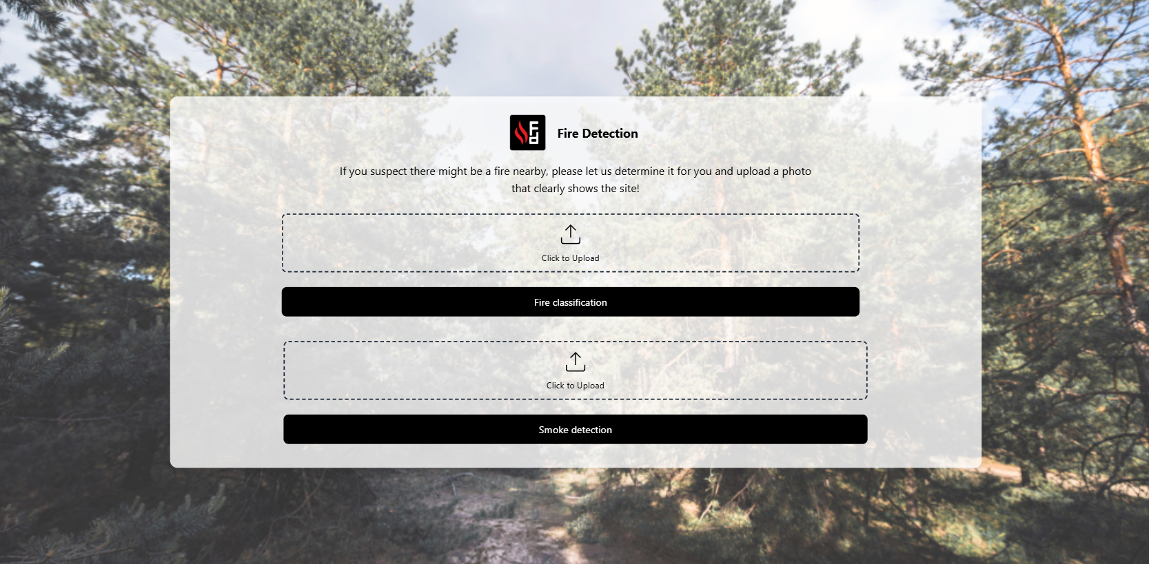
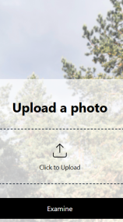
App Screenshots
Below are the screenshots of the application in use.

Slide 5
The user interface allows users to upload an image for analysis either for Fire Classification or Smoke Detection.

Slide 6
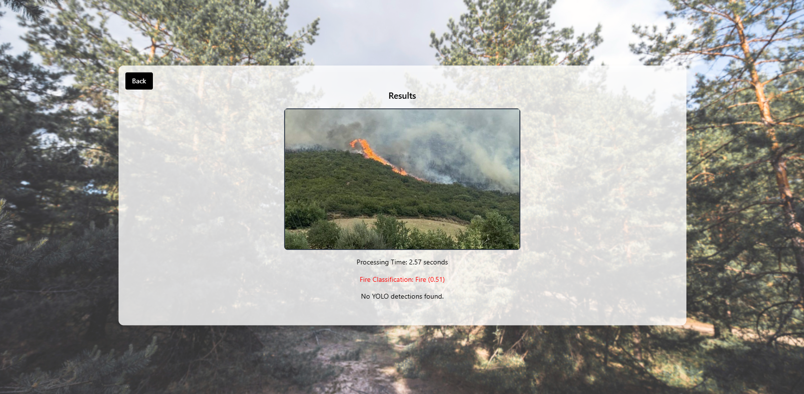
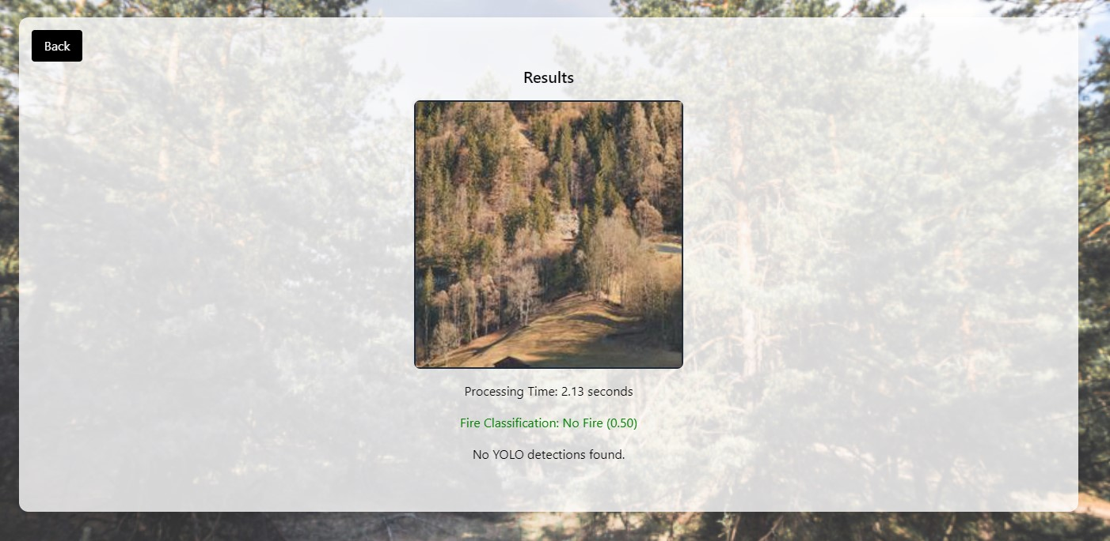
Fire classification in
a fire scenario
No- fire classification in
a fire scenario

Slide 7
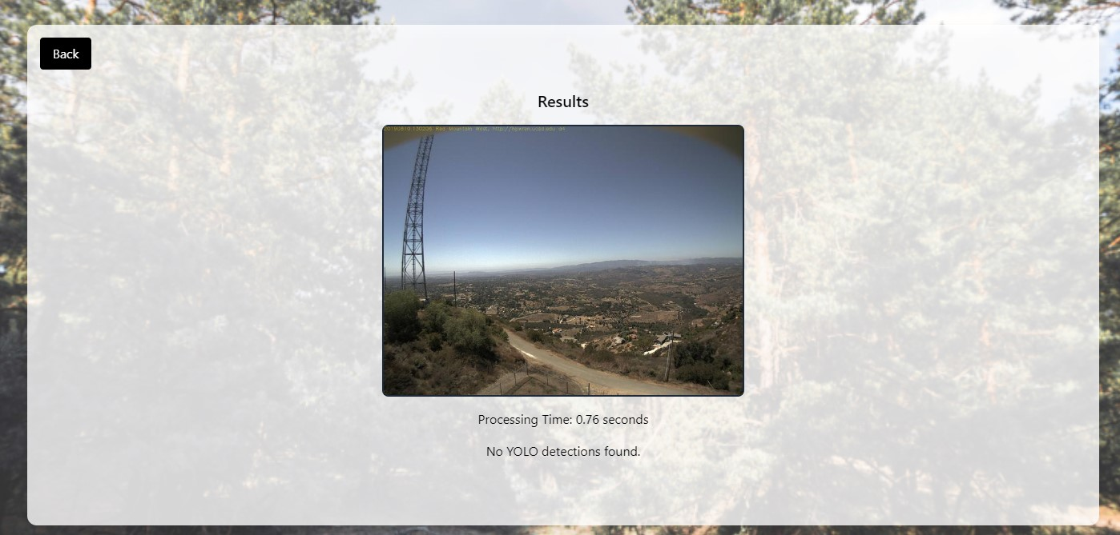
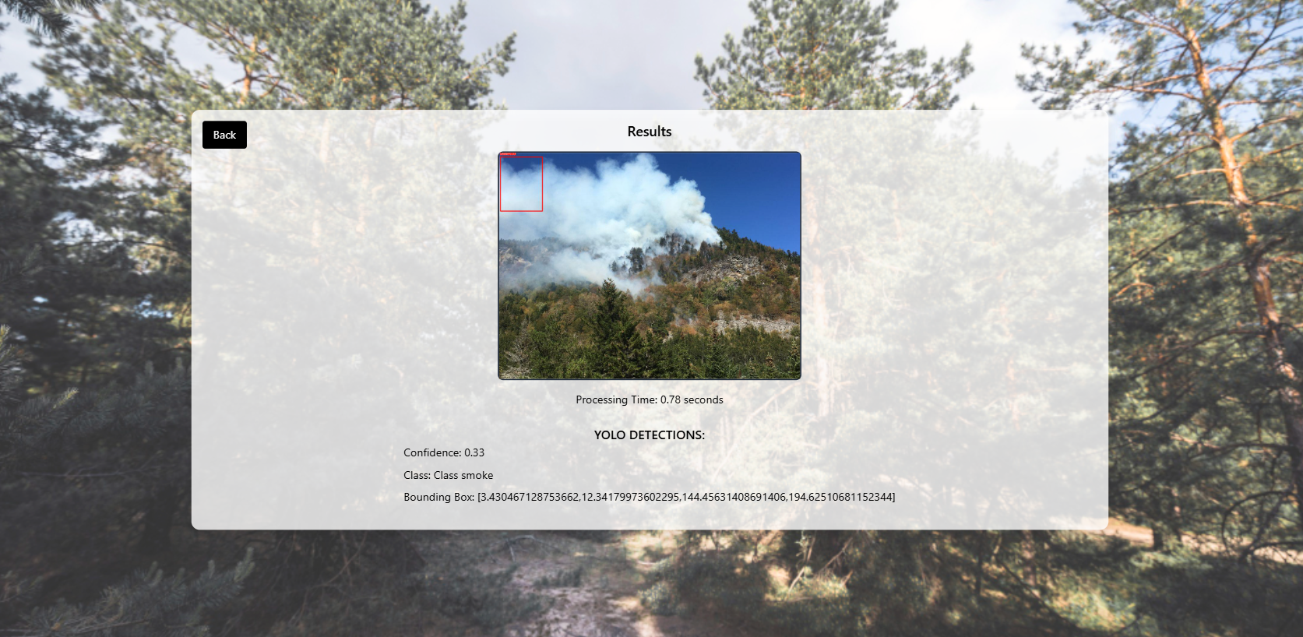
Image Detection in a
no-smoke scenario
Image Detection in a
smoke scenario

Slide 8

Thank you

